Slide 1
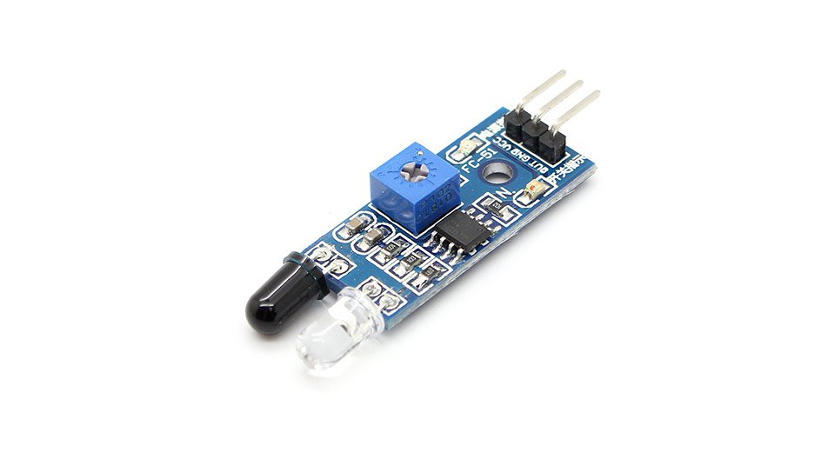
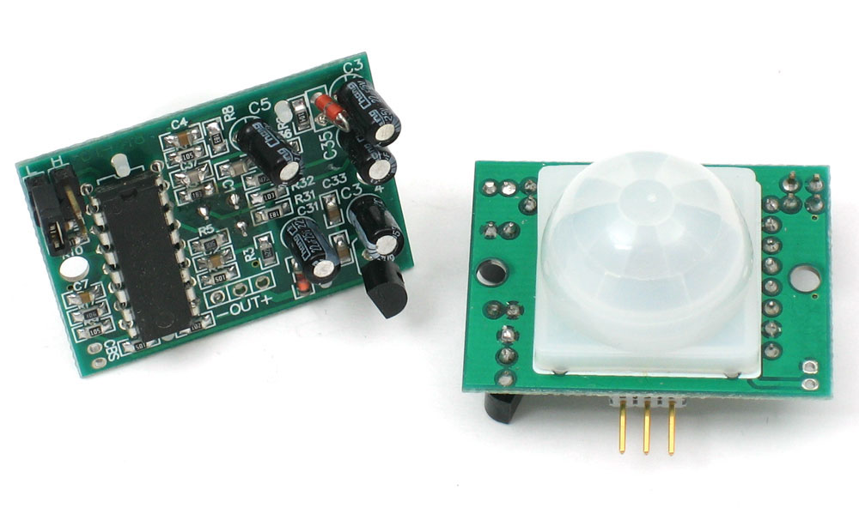


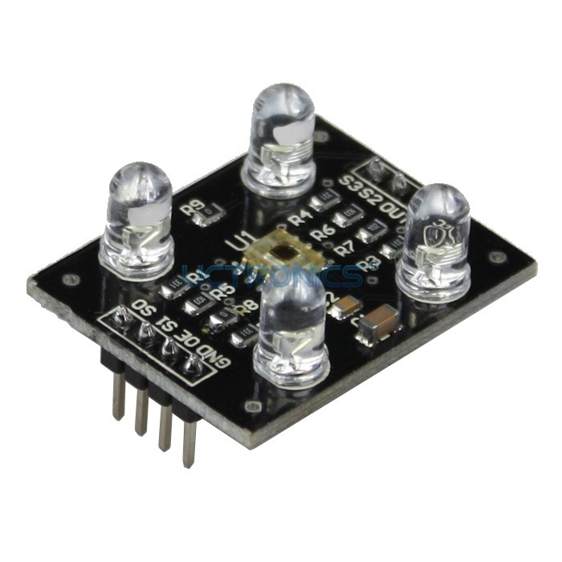
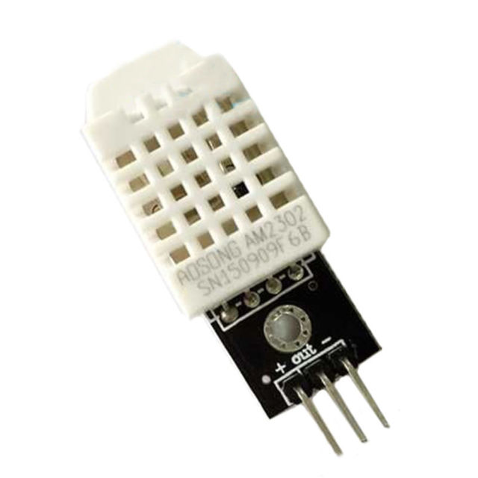
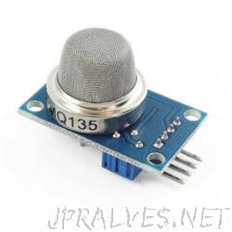
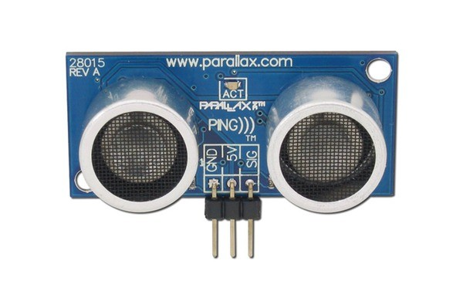
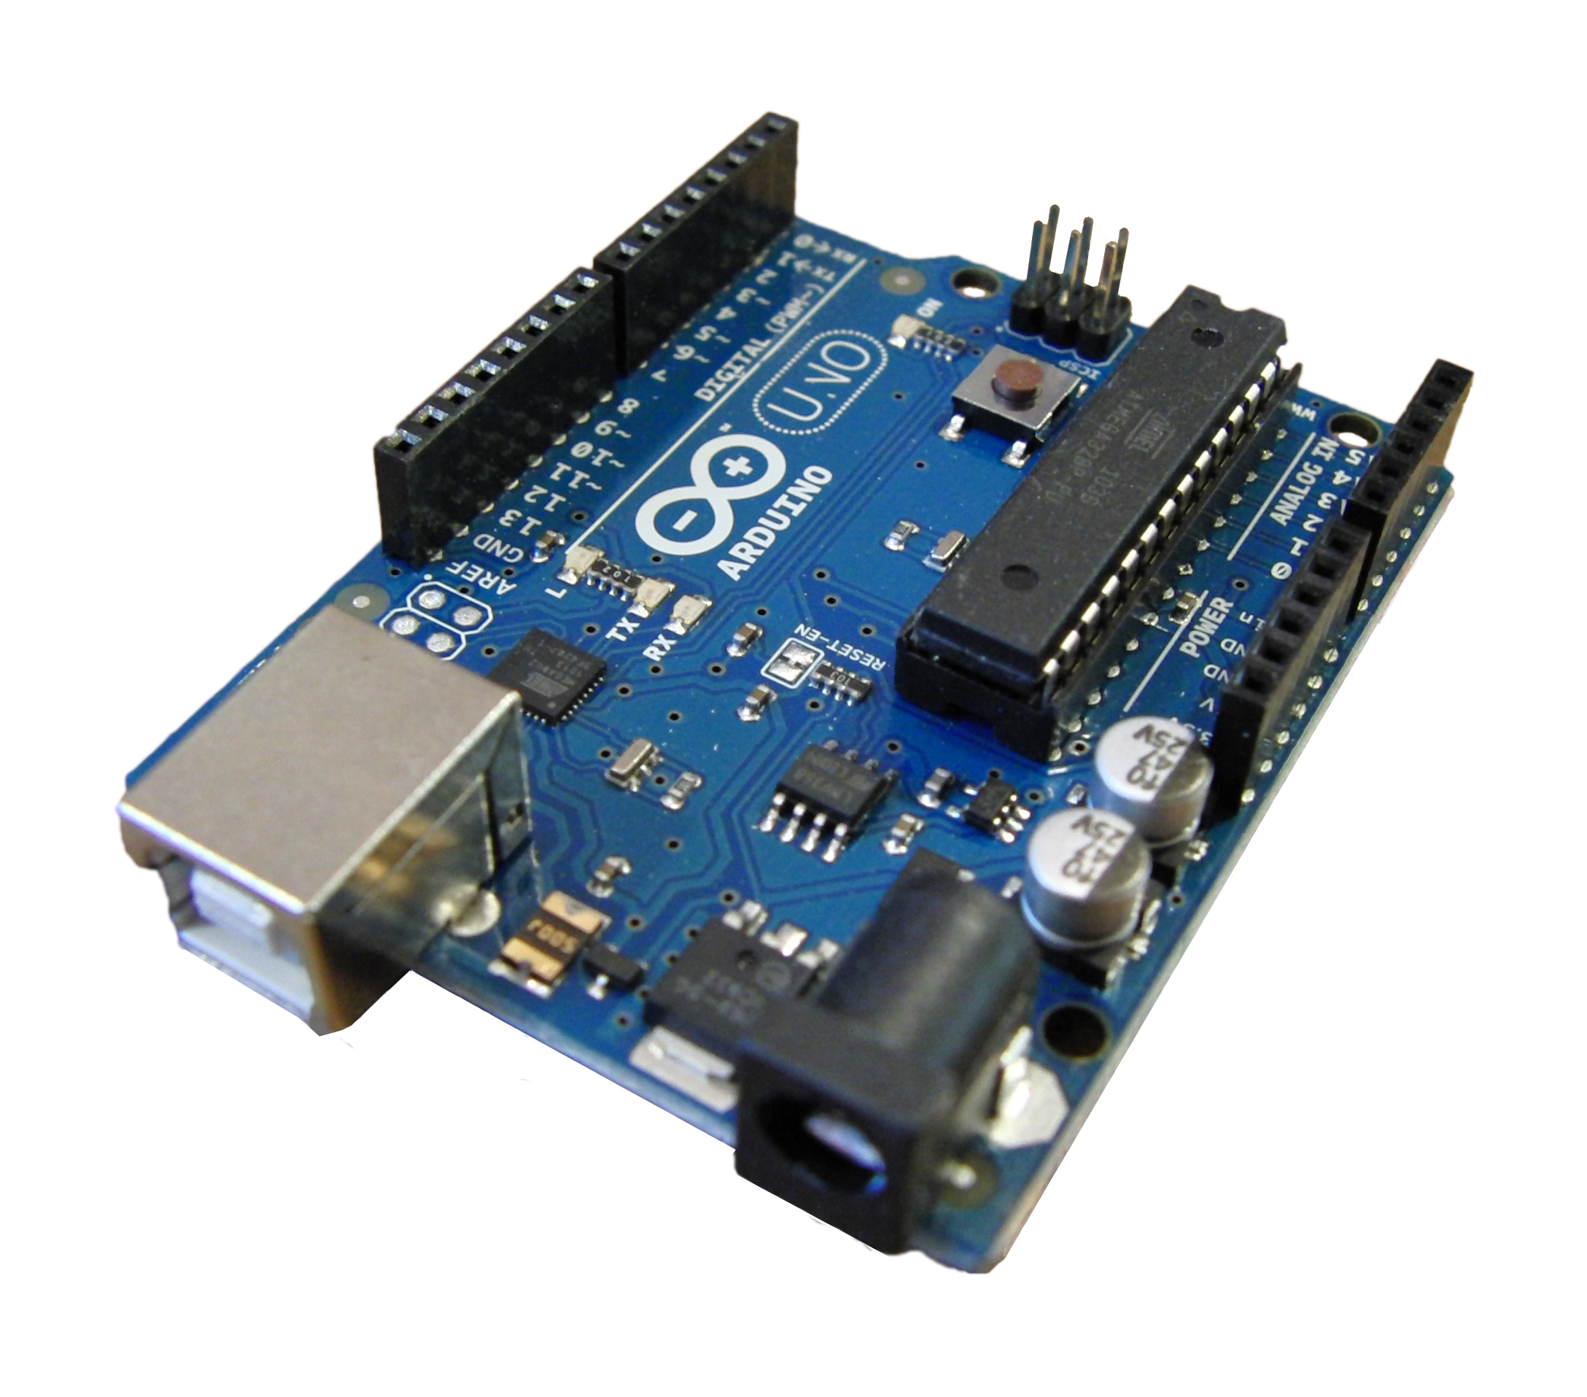
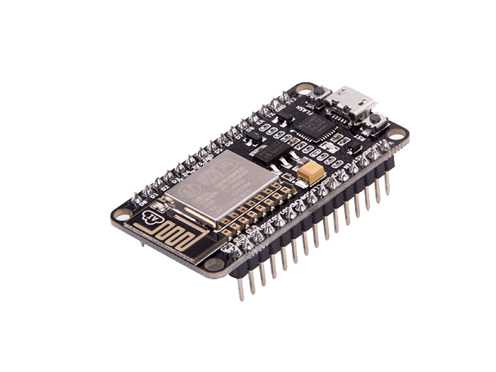
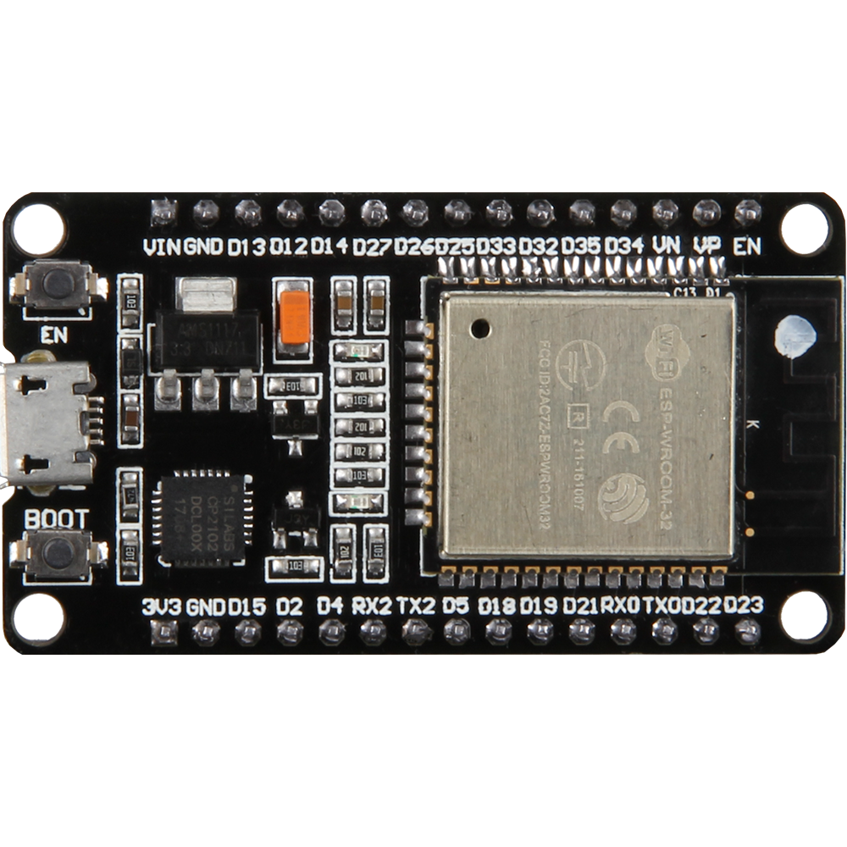
Arduino Step by Step Getting Serious
Name: JOYDIP DUTTA
Branch: Electronics And Communication Engineering
Semester: VII
Roll Number: 17EREEC006

Slide 2

Certificate of Completion of the Course

Slide 3


Slide 4
Course Overview
Getting Familiar with Development Boards
Software Installations
SENSORS, ACTUATORS, AND DISPLAYS
Demonstration Video of some Projects.

Slide 5
Getting Familier with Development Board
SECTION-1
Arduino UNO
NodeMCU ( ESP12E )
ESP32-WROOM-32D

Slide 6
GETTING FAMILIER WITH DEVELOPMENT BOARD
SECTION-1A
INTRODUCTION TO ARDUINO UNO
Open-source hardware platform
Affordable hardware
Easy to set-up for basic applications
Well established community support
Easily expandable functionality with on-top shields and GPIO available on-board
Arduino Uno, Arduino YUN (with Wi-Fi), Arduino MKR family (with Wi-Fi, BLE, LoRa, SigFox and Narrowband IoT)

Slide 7
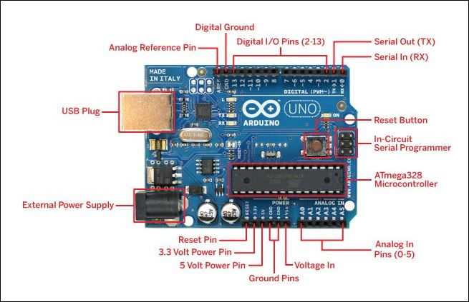
OVERVIEW OF ARDUINO UNO
SECTION-1A

Slide 8
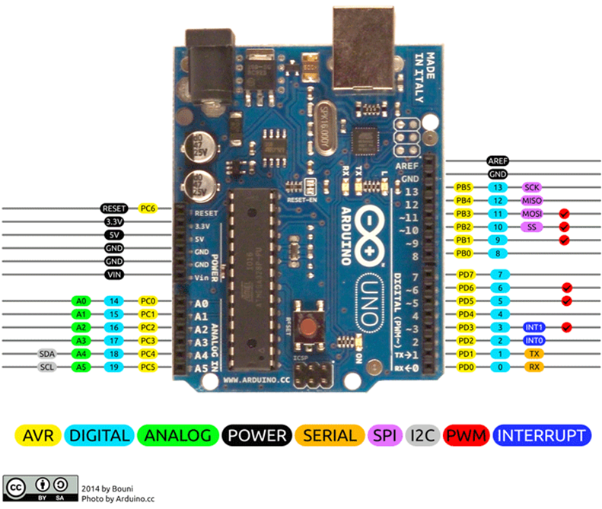
PIN CONFIGURATIONS OF ARDUINO UNO
SECTION-1A

Slide 9
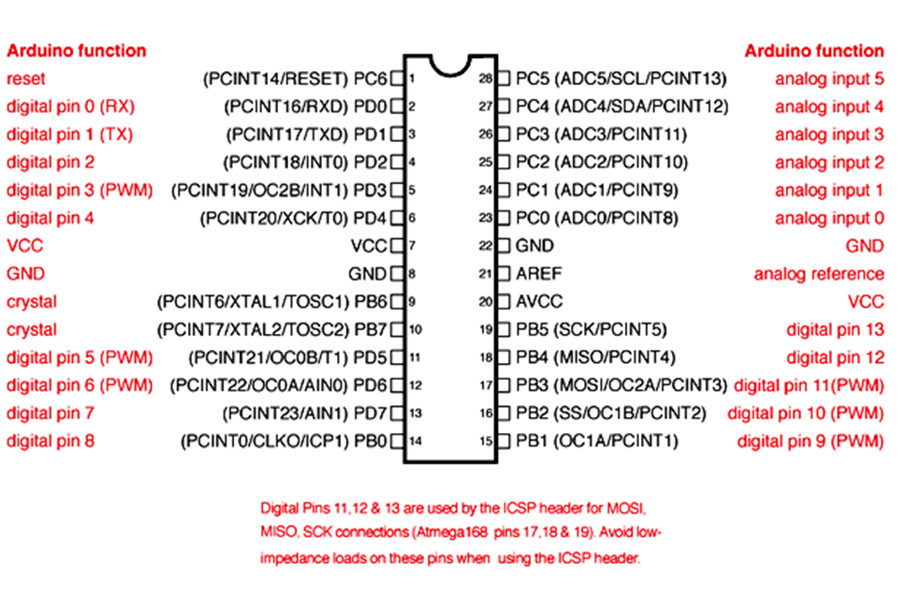
MIND OF THE ARDUINO ( ATMEGA328P)
SECTION-1A

Slide 10
GETTING FAMILIER WITH DEVELOPMENT BOARD
SECTION-1B
INTRODUCTION TO NodeMCU
Also known as ESP8266 development board.
Affordable hardware for IoT Projects.
Easy to set-up for basic applications
Well established community support
NodeMCU is an open-source LUA based firmware developed for the ESP8266 WiFi chip.
Espressif System (A Shanghai-based Semiconductor Company) has released this adorable, bite-sized WiFi-enabled microcontroller - ESP8266 chip.

Slide 11
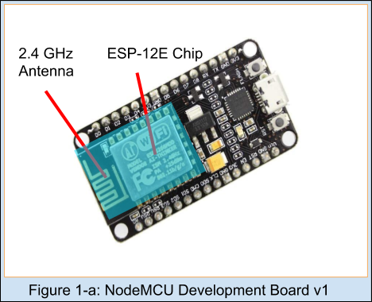
OVERVIEW OF NODEMCU
SECTION-1B
ESP-12E WiFi Module
This ESP-12E module containing an ESP8266 chip having Tensilica Xtensa® 32-bit LX106 RISC microprocessor which operates at 80 to 160 MHz adjustable clock frequency and supports RTOS.
There’s also 128 KB RAM and 4MB of Flash Memory is available which is enough to cope with large strings that make up web pages, JSON/XML data, and everything we use in IoT devices nowadays.
The most versatile feature of NodeMCU is that it can set up a network of its own which allows the other devices to connect directly to it. This is possible because ESP8266 integrates 802.11b/g/n HT40 Wi-Fi transceiver.
This module has 2.4 GHz Antenna which is enough to give us a proper range for our projects.

Slide 12
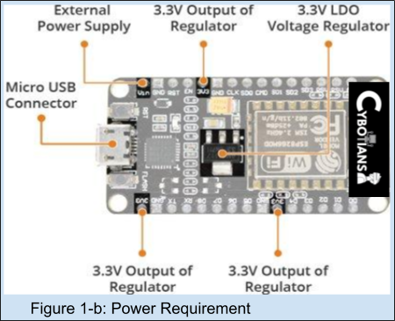
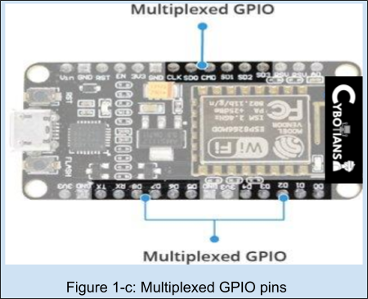
OVERVIEW OF NODEMCU CONTINUES
SECTION-1B
Power Requirements
Operating Voltage: 2.5V to 3.6V
On-board regulator: 3.3V 600mA regulator
Operating Current: 80mA
Current during Sleep Mode: 20 µA
Peripherals & Input/Output
Total GPIO pins: 17
ADC channel: A 10-bit ADC channel
UART interface: UART interface is used to load code serially.
PWM outputs: PWM pins for dimming LEDs or controlling motors.
SPI & I2C: SPI and I2C interface to hook up all sorts of sensors and peripherals.
I2S Interface: I2S interface if you want to add sound to any project.
Multiplexing Feature: A single GPIO pin can act as PWM/UART/SPI.

Slide 13
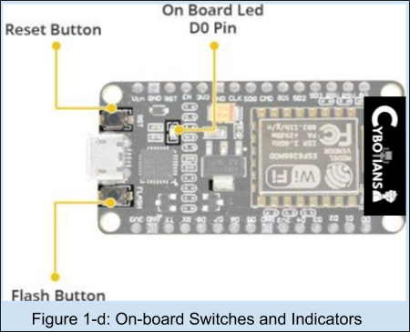
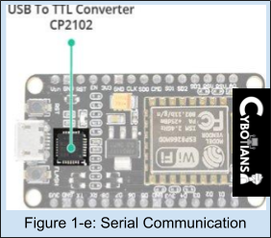
OVERVIEW OF NODEMCU CONTINUES
SECTION-1B
On Board Switches & LEDs
RST Button: Reset the ESP8266 chip
FLASH Button: Download new programs
Blue LED: Work as an Indicator. (User Programmable)
Serial Communication
CP2102 USB-to-UART converter: It is a bridge converter which converts USB signal to Serial. This allows our computer to program and communicate with the ESP8266 chip.
Communication Speed: 4.5Mbps.

Slide 14
PIN DESCRIPTION OF NODEMCU BOARD
SECTION-1B
Pins (according to functionality) | Availability | Description
Power Pins | One Vin pin, three 3.3V Pins(Vout), and Five ground Pins are available. | Vin Pin: Used to provide power supply to the board directly. 3.3V Pin: Used to supply power to external components.
I2C Pins | D1 and D2 pin are available as an SCL and SDA pin respectively. | D1 and D2 are used to hook up all sorts of I2C Sensors.
GPIO Pins | There are 17 pins are available as GPIO. | These pins can be assigned to various functions programmatically.
ADC Channel | VDD3P3 pin and TOUT pin. | Used as an ADC pin but cannot be implemented at the same time.
UART Pins | UART0 ( TXD0, RXD0, RST0, and CTS0 Pins ) UART1 ( TXD1 Pin) | UART0: can be used for communication and it supports fluid control. UART1: It features only the data transmit signal.

Slide 15
PIN DESCRIPTION OF NODEMCU BOARD CONTINUES
SECTION-1B
Pins (according to functionality) | Availability | Description
SPI Pins | SPI and HSPI Pins. | Supports 4 timing modes of the SPI format transfer.
PWM Pins | Four Channels of PWM. | PWM can be implemented programmatically. The frequency range is adjustable from 1000 μs to 10000 μs, i.e., between 100Hz and 1 kHz.
Control Pins | Enable Pin(EN), Reset Pin(RST) & WAKE pin. | EN pin: Control the ESP8266 chip by set it as a HIGH and LOW. RST pin: Used to Reset the ESP8266 chip. WAKE pin: Used to wake the chip from a deep-sleep mode.
SPI Pins | SPI and HSPI Pins. | Supports 4 timing modes of the SPI format transfer.

Slide 16
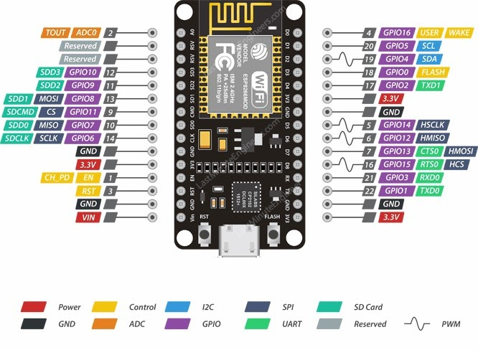
PIN DESCRIPTION OF NODEMCU BOARD CONTINUES
SECTION-1B
https://cybotians.com
https://cybotians.com
https://cybotians.com

Slide 17
GETTING FAMILIER WITH DEVELOPMENT BOARD
SECTION-1C
INTRODUCTION TO ESP32
ESP32 is a series of low cost, low power system on chip microcontrollers with integrated Wi-Fi & dual-mode Bluetooth.
Easy to set-up for basic applications
Well established community support
ESP32 is created and developed by Espressif Systems, a Shanghai-based Chinese company

Slide 18
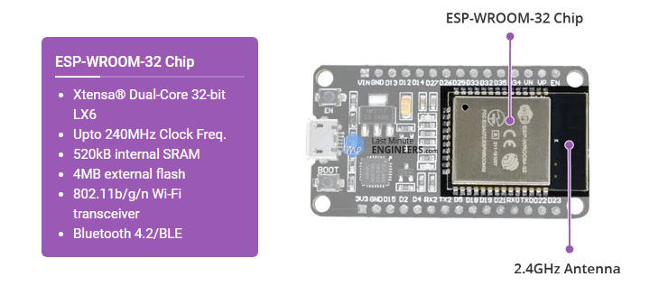

OVERVIEW OF ESP32
SECTION-1C

Slide 19
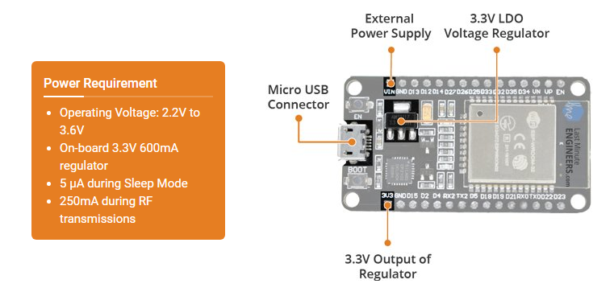
OVERVIEW OF ESP32
SECTION-1C

Slide 20
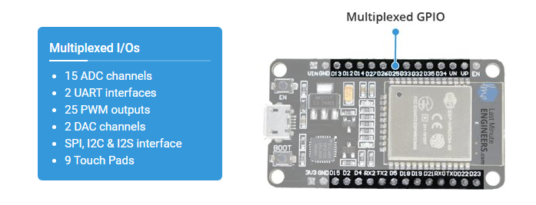
OVERVIEW OF ESP32
SECTION-1C

Slide 21
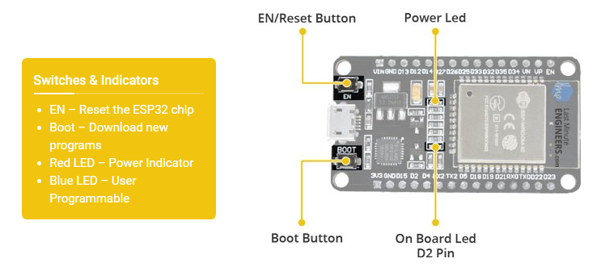
OVERVIEW OF ESP32
SECTION-1C

Slide 22
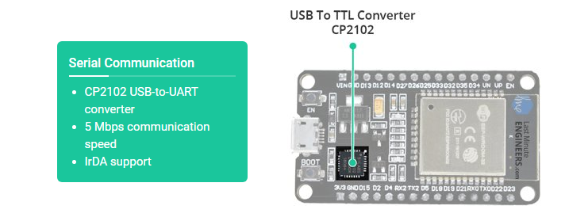
OVERVIEW OF ESP32
SECTION-1C

Slide 23
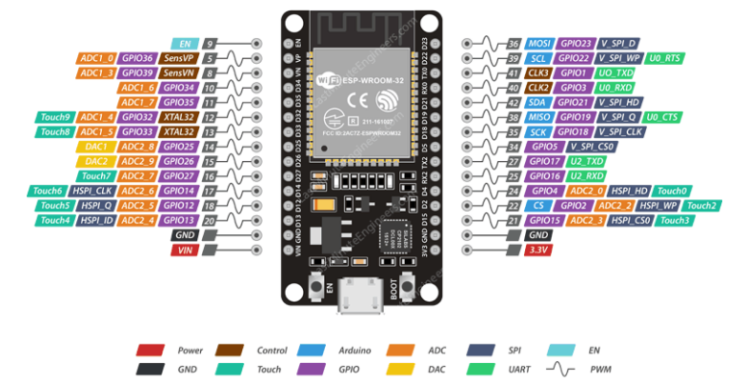
PIN DESCRIPTION OF ESP32-WROOM-32
SECTION-1C
https://cybotians.com
https://cybotians.com
https://cybotians.com

Slide 24
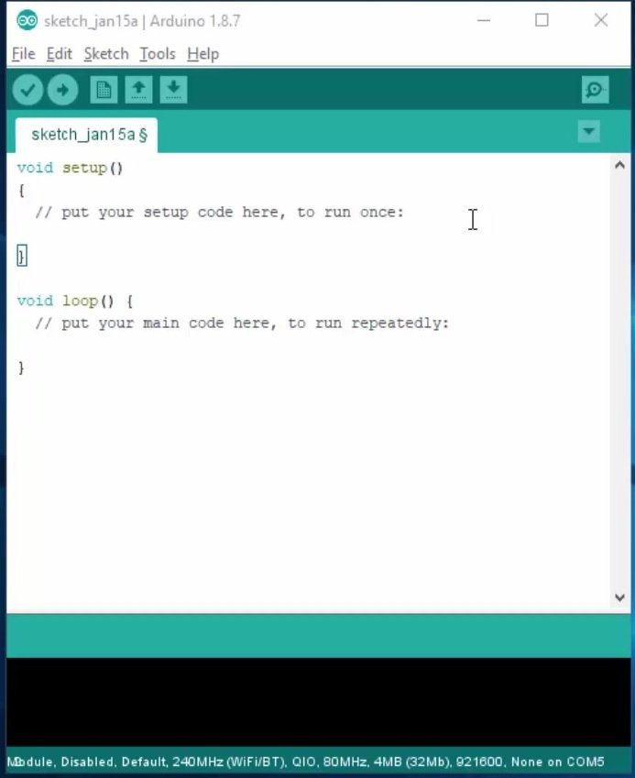

SOFTWARE INSTALLATIONS
SECTION-2
Arduino IDE

Slide 25
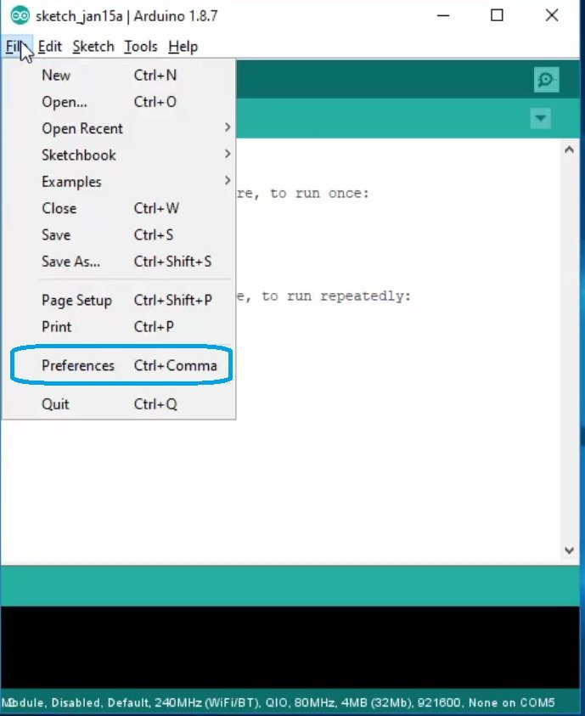
SOFTWARE INSTALLATIONS CONTINUES
SECTION-2A

Slide 26
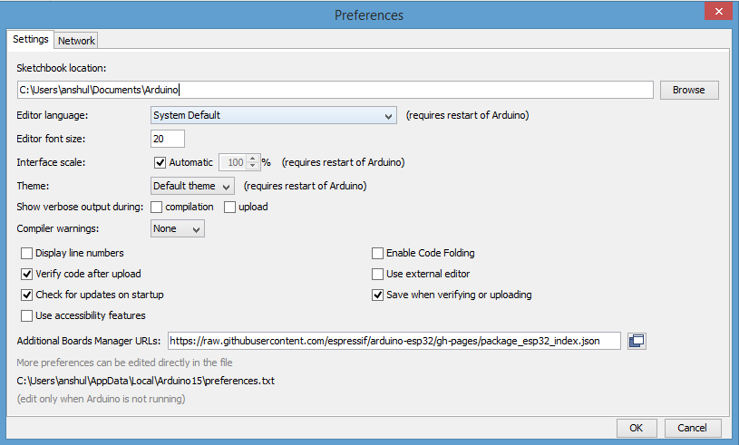
SOFTWARE INSTALLATIONS CONTINUES
SECTION-2A
http://arduino.esp8266.com/stable/package_esp8266com_index.json ,
https://raw.githubusercontent.com/espressif/arduino-esp32/gh-pages/package_esp32_index.json

Slide 27
SENSORS, ACTUATORS, AND DISPLAYS
Sensors
A sensor detects (senses) changes in the ambient conditions or the state of another device or a system, and forwards or processes this information in a certain manner. They perform some input functions by sensing or feeling the physical changes in characteristics of a system in response to stimuli. For example, heat is converted to electrical signals in a temperature sensor, or atmospheric pressure is converted to electrical signals in a barometer.

Slide 28
SENSORS, ACTUATORS, AND DISPLAYS
Actuators
An actuator is a component of a machine or system that moves or controls the mechanism or the system. An actuator is a mechanism by which a control system acts upon an environment An actuator requires a control signal and a source of energy. Upon receiving a control signal, the actuator responds by converting the energy into mechanical motion. The control system can be simple (a fixed mechanical or electronic system), software‐based (e.g. a printer driver, robot control system), a human, or any other input.

Slide 29
SENSORS, ACTUATORS, AND DISPLAYS
Displays
A display device is an output device for the presentation of information in a visual or tactile form (the latter used for example in tactile electronic displays for blind people). When the input information that is supplied has an electrical signal the display is called an electronic display. Here, I have discussed the interfacing of some common display boards with Arduino Uno.

Slide 30
Before starting the interfacing, Let’s See Where to find the codes for this topic
https://github.com/joydipdutta001/ArduinoStepByStep

Slide 31
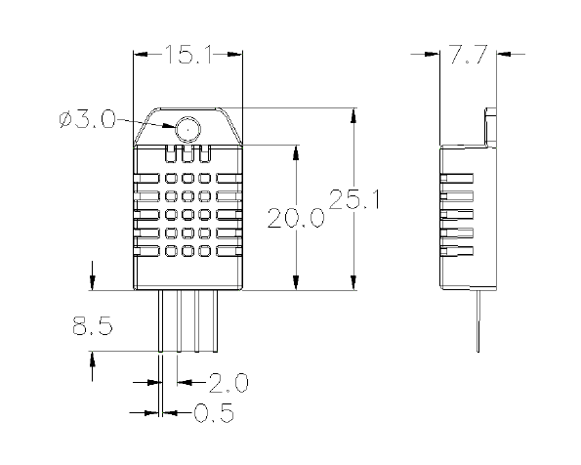
Temperature and Humidity Sensor ( DHT22 )
Technical Specifications:
Operating Voltage: 3.5V to 5.5V
Operating current: 0.3mA (measuring) 60uA (standby)
Output: Serial data
Temperature Range: -40°C to 80°C
Humidity Range: 0% to 100%
Resolution: Temperature and Humidity both are 16-bit
Accuracy: ±0.5°C and ±1%

Slide 32
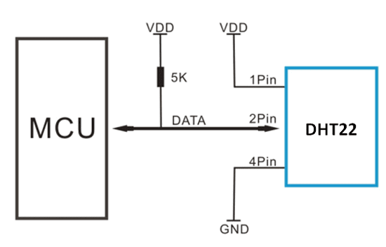
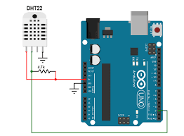
How to Use DHT22 Sensor module:
Circuit Diagram ( Schematics ):
Pin | Wiring to Arduino Uno
1st pin- VCC | 5V
2nd pin- DataOUT | Digital pin 2
3rd pin | Not need to connect
4th pin- GND | GND

Slide 33
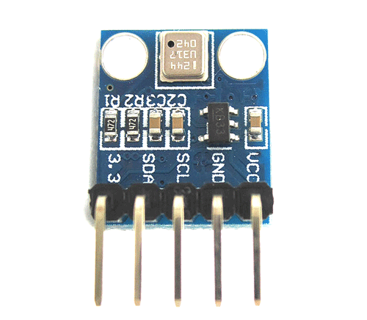
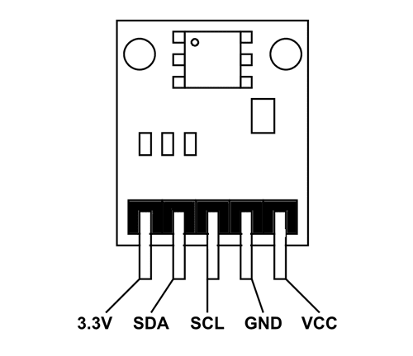
Environmental Sensor ( BMP180 )
Technical Specifications:
Operating voltage of BMP180: 1.3V – 3.6V
An input voltage of BMP180MODULE: 3.3V to 5.5V
Peak current: 1000uA
Consumes 0.1uA standby
Maximum voltage at SDA , SCL : VCC + 0.3V
Operating temperature: -40ºC to +80ºC

Slide 34
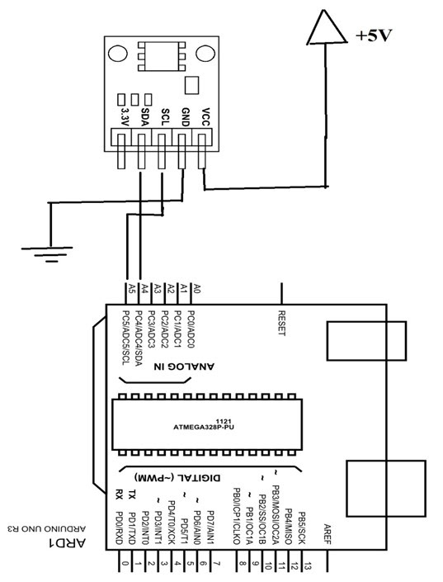
How to Use MP180 Module?
Circuit Diagram ( Schematics ):
Pin | Wiring to Arduino Uno
Vin | 5V
GND | GND
SCL | A5
SDA | A4

Slide 35
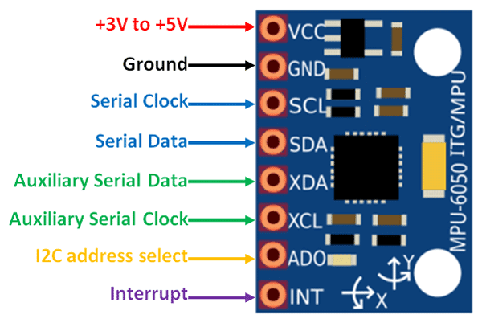
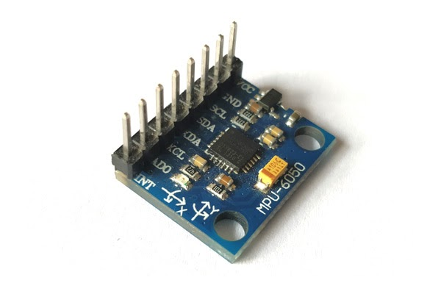
Motion Sensor and Accelerometer ( MPU6050 )
Technical Specifications:
MEMS 3-axis accelerometer and 3-axis gyroscope values combined
Power Supply: 3-5V
Communication: I2C protocol
Built-in 16-bit ADC provides high accuracy
Built-in DMP provides high computational power
In-built temperature sensor

Slide 36
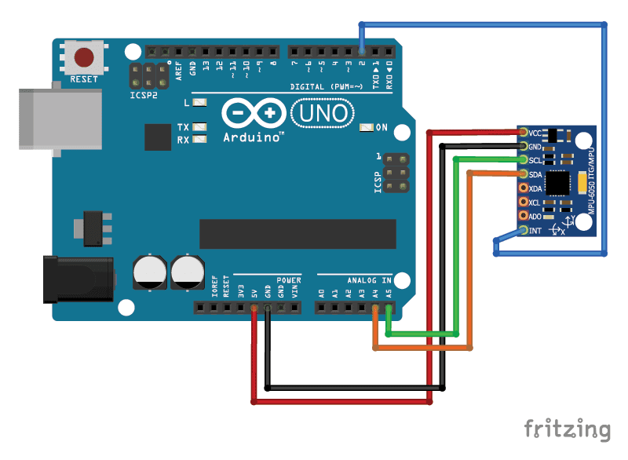
How to Use MPU6050 Module?
Circuit Diagram ( Schematics ):
Pin | Wiring to Arduino Uno
Vin | 5V
GND | GND
SCL | A5
SDA | A4
INT | 2

Slide 37
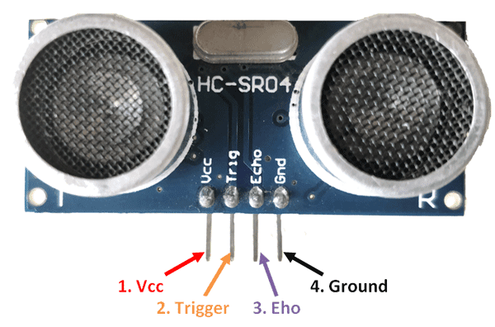
Ultrasonic Distance Sensor ( HC-SR04 )
Technical Specifications:
Operating voltage: +5V
Theoretical Measuring Distance: 2cm to 450cm
Practical Measuring Distance: 2cm to 80cm
Accuracy: 3mm
Measuring angle covered: <15°
Operating Current: <15mA
Operating Frequency: 40Hz

Slide 38
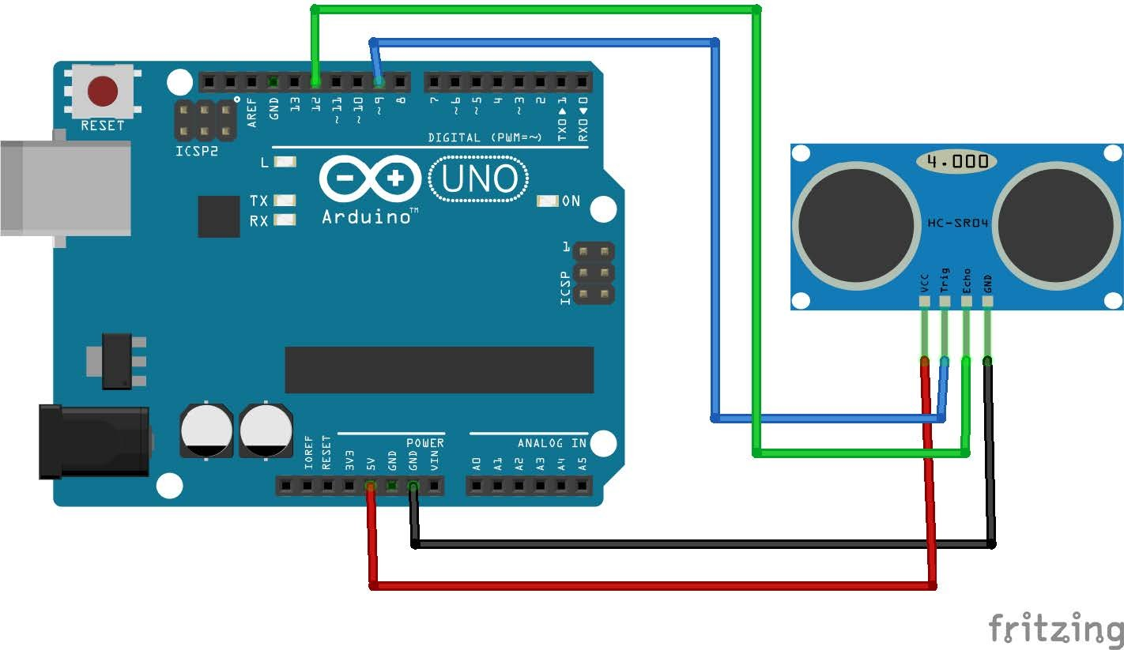
How to Use HC-SR04 Module?
Circuit Diagram ( Schematics ):
Pin | Wiring to Arduino Uno
VCC | 5V
Trig | 9
Echo | 12
GND | GND

Slide 39
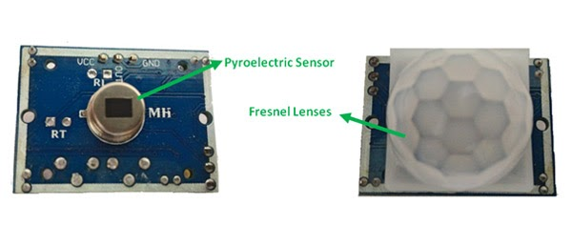
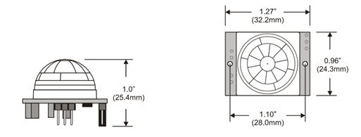
Passive Infrared Sensor ( PIR )
Technical Specifications:
Wide range on input voltage varying from 4.V to 12V (+5V recommended)
The output voltage is High/Low (3.3V TTL)
Can distinguish between object movement and human movement
Has to operate modes - Repeatable(H) and Non- Repeatable(H)
It can cover a distance of about 120° and 7 meters
Low power consumption of 65mA
Operating temperature from -20° to +80° Celsius

Slide 40
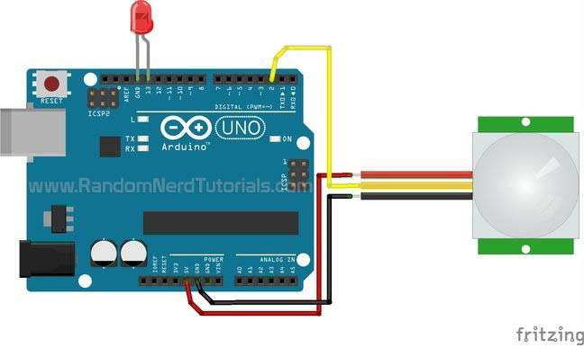
How to Use PIR Module?
Circuit Diagram ( Schematics ):
Pin | Wiring to Arduino Uno
VCC | 5V
OUT | 2
GND | GND

Slide 41
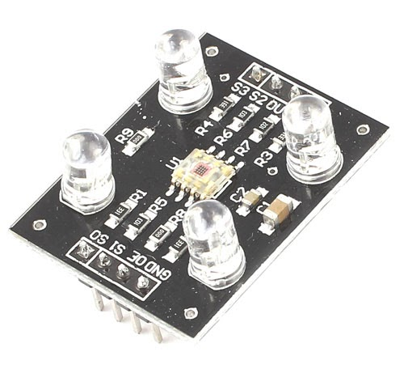
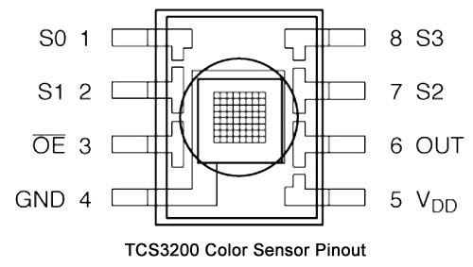
Color Sensor Module ( TCS320 )
Technical Specifications
Input voltage: (2.7V to 5.5V)
Interface: Digital TTL
High-resolution conversion of light intensity to frequency
Programmable color and full-scale output frequency
No need for ADC(Can be directly connected to the digital pins of the microcontroller)
Power down feature
Working temperature: -40oC to 85oC
Size: 28.4x28.4mm(1.12x1.12")

Slide 42
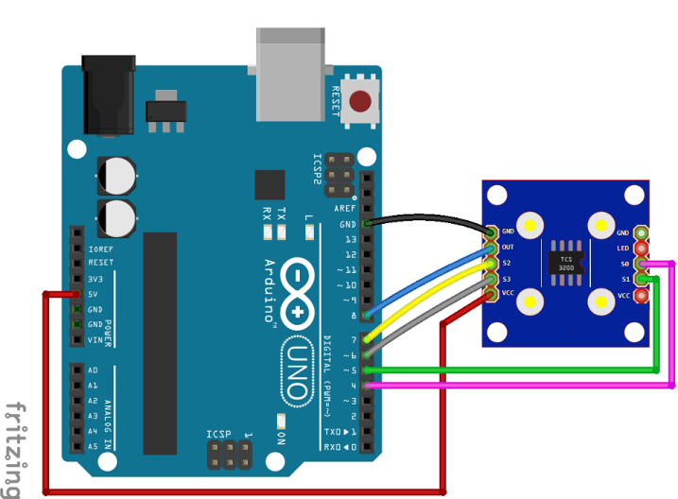
How to Use TCS3200 Color Sensor Module?
Circuit Diagram ( Schematics ):
Pin | Wiring to Arduino Uno
S0 | Digital Pin 4
S1 | Digital Pin 5
VCC | 5V
S3 | Digital Pin 6
S4 | Digital Pin 7
OUT | Digital Pin 8

Slide 43
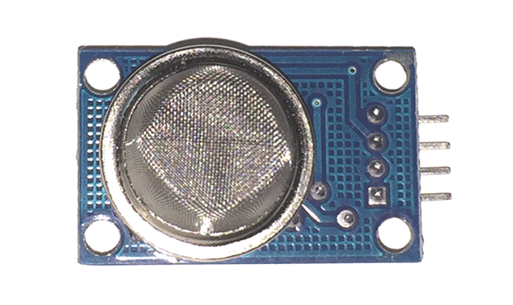
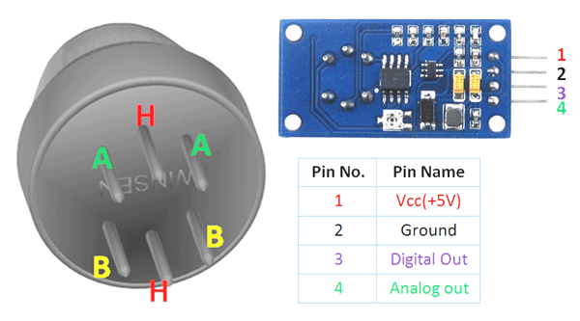
Gas Sensor Module ( MQ135 )
Technical Specifications
Wide detecting scope
Fast response and High sensitivity
Stable and long life
Operating Voltage is +5V
Detect/Measure NH3, NOx, alcohol, Benzene, smoke, CO2, etc.
Analog output voltage: 0V to 5V
Digital output voltage: 0V or 5V (TTL Logic)
Preheat duration 20 seconds
Can be used as a digital or analog sensor

Slide 44
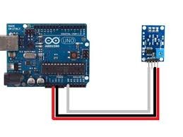
How to Use MQ135 Gas Sensor Module?
Circuit Diagram ( Schematics ):
Pin | Wiring to Arduino Uno
A0 | Analog pin A0
VCC | 5V
GND | GND

Slide 45
Displays And Actuators
Displays:
Liquid Crystal Display (LCD) Module ( Size: 2x16 )
Seven Segment Displays (Single Digit)
An 8x8 LED matrix display
Actuators:
DC Motors And Arduino Uno
Servo Motors And Arduino Uno

Slide 46
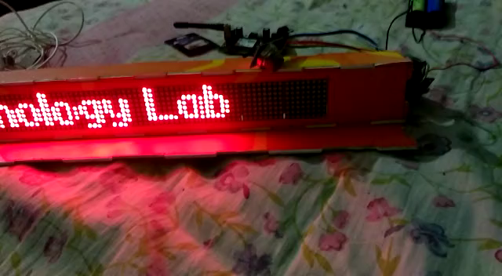
Project: Wireless Display Board with Temperature, Humidity and Smoke Measurement
Let’s See Some Demo

Slide 47
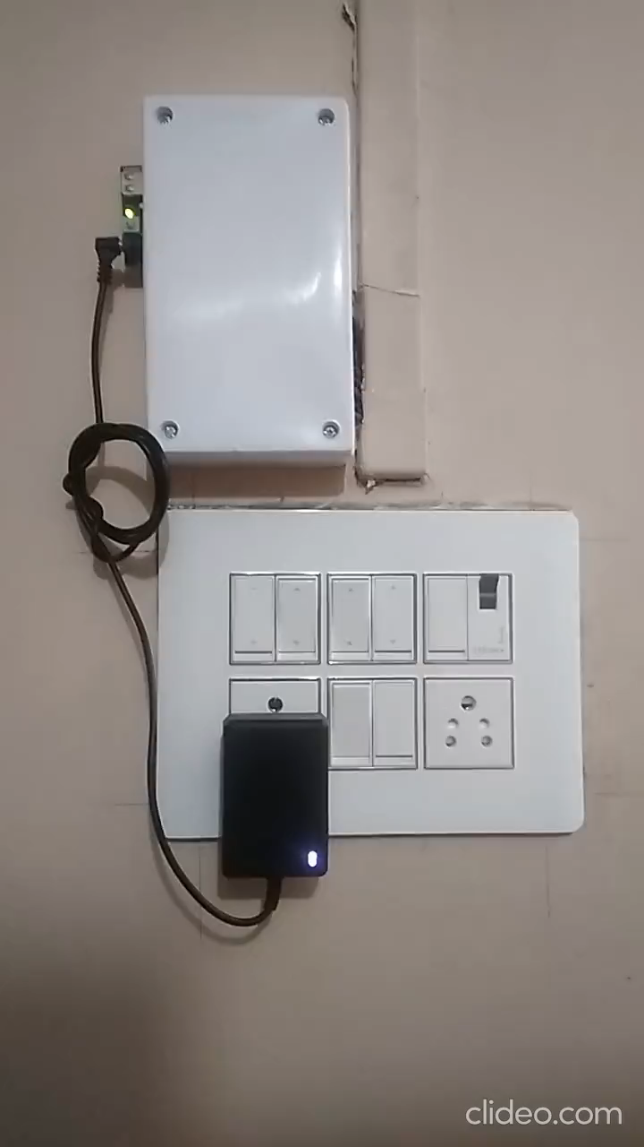
Project: Room Automation With Android App And Two way Switching
Let’s See Some Demo Continues

Slide 48
THANK YOU

